Slide 1
ENSE 374, MILESTONE 1
UR XTECH
KADEN GOSKI
JULIO ANDRÉS SILVA VÁSQUEZ
PRECIOUS WANGWE
OCTOBER 2ND 2019

Slide 2
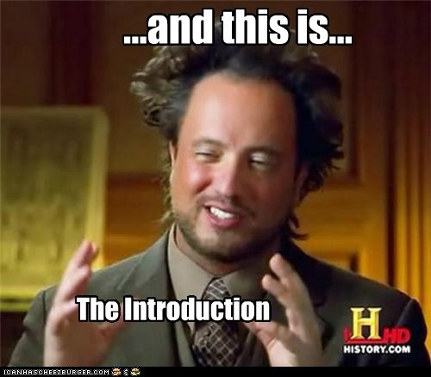
TEAM INTRODUCTIONS
We are UR XTech
https://github.com/alpacamusical/Project-ENSE-374

Slide 3
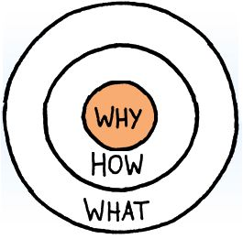
ELEVATOR PITCH
Our Golden Circle
  “Why”: To make it simpler
  “How”: With our development team and resources from the U of R.
  “What”: An application to review movies.

Slide 4
INITIAL SYSTEM & FUNCTIONAL REQUIREMENTS
What exactly are we doing?
  An application to review movies but simpler than IMDB or Fandango with an scrum ish methodology.
What gap are we trying to fill?
  We are a small team but we think big.
Project vision
Project rationale
Envisioned stakeholders
Discuss assumptions

Slide 5
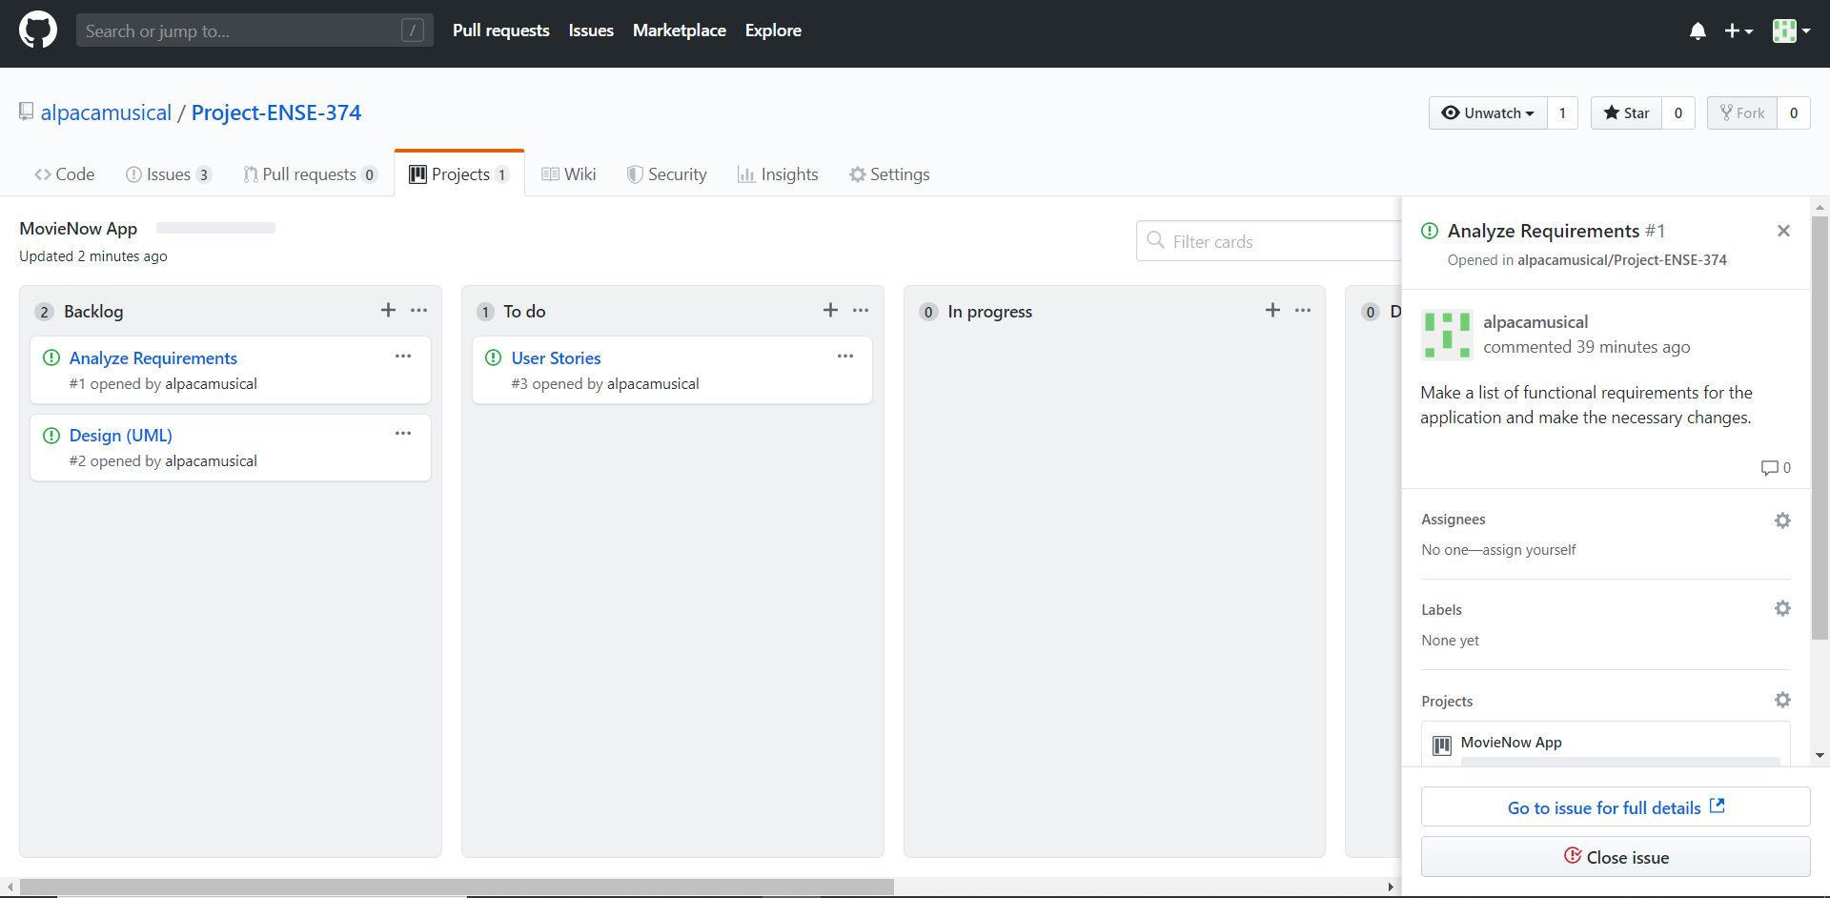
INITIAL KANBAN
Illustrate your Kanban (in GitHub)
Highlight user stories in your product backlog and other sections
  Focus on key activities
  Be cognizant of your allotted presentation time

Slide 6
OUR GITHUB
It will work with three different branches.
For now it only has milestone and user stories documentation.

Slide 7
MISC.
Add other insights if you like but remember, your group’s report-out must be kept within 5 minutes

Slide 8
GROUP REFLECTION
How did you feel about this milestone? What did you like about it? What did you dislike?
  [Response here]
What did you learn about yourself as you collaborated and worked through this milestone?
  [Response here]
How will you use what you have learned going forward?
  [Response here]
What “stuff & things” related to this milestone would you want help with?
  [Response here]

